Slide 1

JIGSAW - LMS
INSTITUTE ERP
LEAD | MANAGE | SUPERVISE

Slide 2
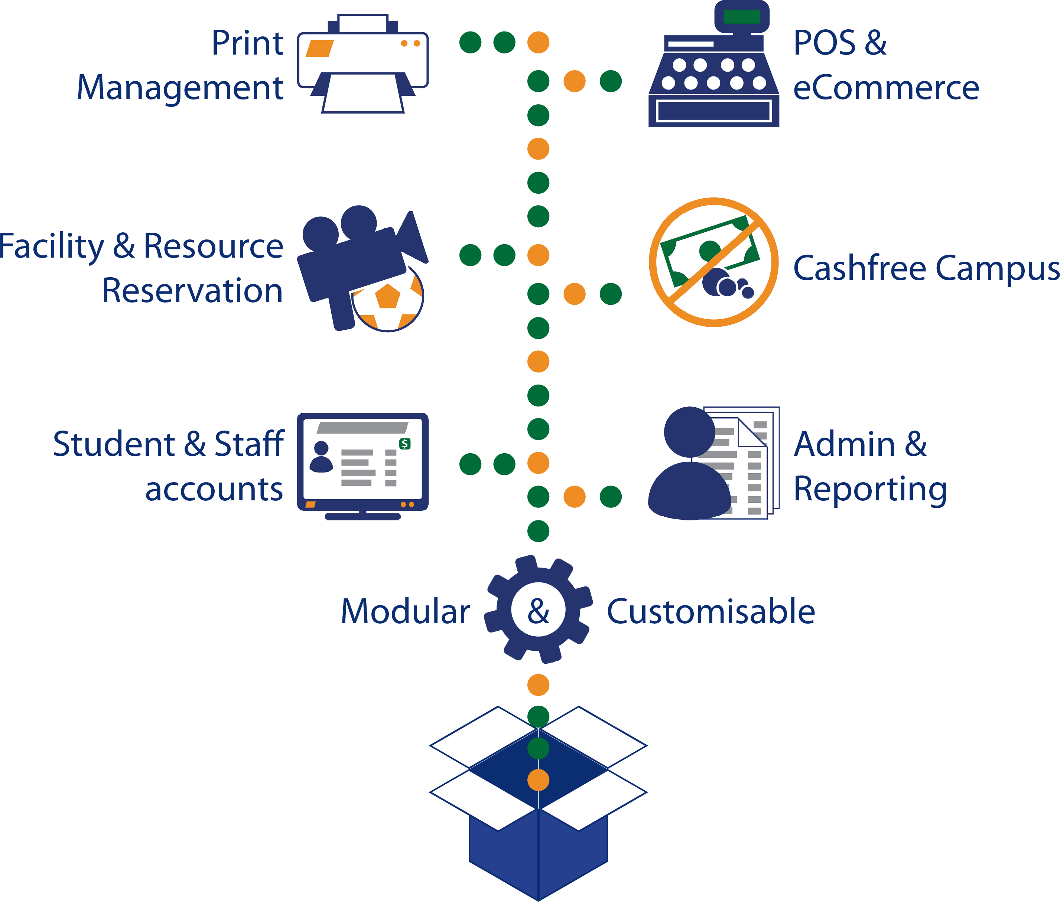
ADMIN @ WORK
Admin has exclusive rights to create:
Backend Team
Marketing Team
Job Assignment
Franchisees
Study Material-Pdfs-Videos-others
List of Courses
Course Structure
Inventory Creation
Study Material Prices for Franchisees
Reward Management
Referral Program Management

Slide 3

MODULES FOR FRANCHISE?
Live Classes
Course Management
Study Material
Student Management
Parent Management
Teacher Management
Attendance Management
Fee Management
Enquiry Management
SMS & Announcements
Batch Management
Stock Management
Pre & Post Assessment
Online Exam Management
Offline Exam Management
Quiz Management
Practice Sessions
Assignment Management

Slide 4
HOW IT WORKS @ FRANCHISE END?
Franchise can create:
Teachers
Students
Parents
Batches
Fee Structure

Slide 5
Modules that teacher can handle are:
ROLE OF TEACHER
Live Classes with recordings
Study Material
Student Management
Parent Management
Batch Management
Attendance Management
Fee Management
Enquiry Management
SMS Management
Local Stock Management
Pre & Post Assessment
Online Exam Management
Offline Exam Management
Quiz Management
Practice Sessions
Assignment Management
Announcements

Slide 6

WORK FLOW

Slide 7

WORK FLOW
Franchise/teacher will register a student.
Franchise will update the fee structure for the student.
If any discount is given that will be updated.
Once fee is clear, course/batch/level will be allocated to the student.
Accordingly, study material will be assigned after approval from the backend team/admin.
Now, student/parents have the access with credentials.

Slide 8

STUDENT/PARENT PANEL
GET THE DETAILS
My Profile
Live Classes
Quizzes & Extra Practices
Online Tests & Assignments
Attendance Report
Benefits Club: Structure & Awards
SWOT Analysis
Classes Schedule
Fee Update
Study Material
Results & Certificates
Chats & Announcements
FILL THE FORMS
Referrals
Feedback Form

Slide 9

BACKEND TEAM PANEL
ADD THE DETAILS
My Profile
Franchise Creation
Teacher Creation
Students/Parents Creation
Course Creation
Fee structure
Exams Creation
Inventory Creation
Inventory Cost
Quizzes & Extra Practices
Online Tests & Assignments
Study Material
Certificates to Students
Assign Targets
Add Daily Report
GET THE DETAILS
Franchise Report
Teacher Report
Student report

Slide 10


MARKETING TEAM PANEL
DETAILS
My Profile
Get Targets
Add Daily Report
Get Online Queries
Reporting System
Fill Queries and Remarks

